Slide 1
The HNSB. Ltd. Science College Himatnagar
M.Sc. Sem: III
2020-21
Paper: CHNN 703
Subject: Medicinal Chemistry
Topic: Literature of Medicinal Chemistry
Presented By: Dr. Z. M. Gadhawala

Slide 2
We can divided literature of medicinal chemistry in the following category:
Standard Textbook
Reference book
Journal
Review
Abstract
Treatise
Encyclopedia
Standard Data book
Pharmacopeias
Patents

Slide 3
Standard Textbook
A textbook is a manual of instruction in any branch of study.
Textbook are produced according to their demands of education institutions.
Now a days most textbook are not published in printed format, many are now available as online electronic books.
Standard textbook cover general aspects.
Advanced level aspects may or may not given.
Price of this book is low cost.
Issued min’s we can get it very easily.
E.g. –Jerry March ( Too much references)
-Morison Boyd (Does not mention any references)
-Carey & Sundberg
-I. L. FINAR (Gives general references)

Slide 4
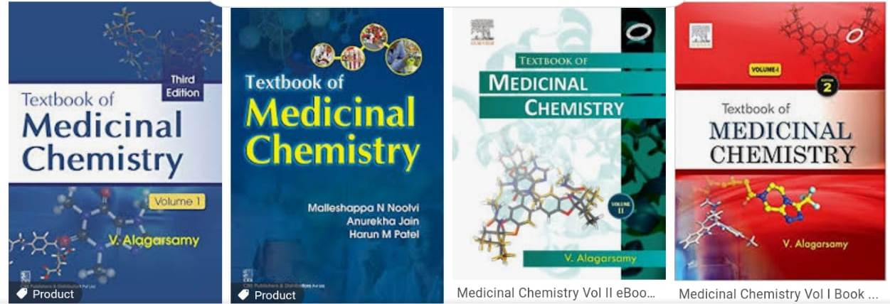

Slide 5
Reference Book
A book which have only specific topic known as reference book.
Reference book are sources you should reference to for a broad, factual overview on variety verity of topics.
It’s cover detailed aspect of a limited area.
High Cost.
Not issued in library.
E.g. –Burger’s Medicinal Chemistry

Slide 6
Journals
Journal is periodicals.
This is original literature.
Journal is primary source.
Some parts of journals comes in chemical abstracts.

Slide 7
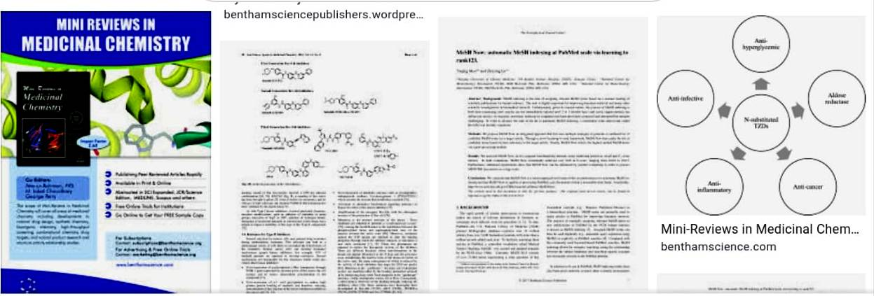
Reviews
Work of research person is called reviews.
It is also identical to thesis.
e.g. –For developing anti AIDs drugs you have to check all journals.

Slide 8
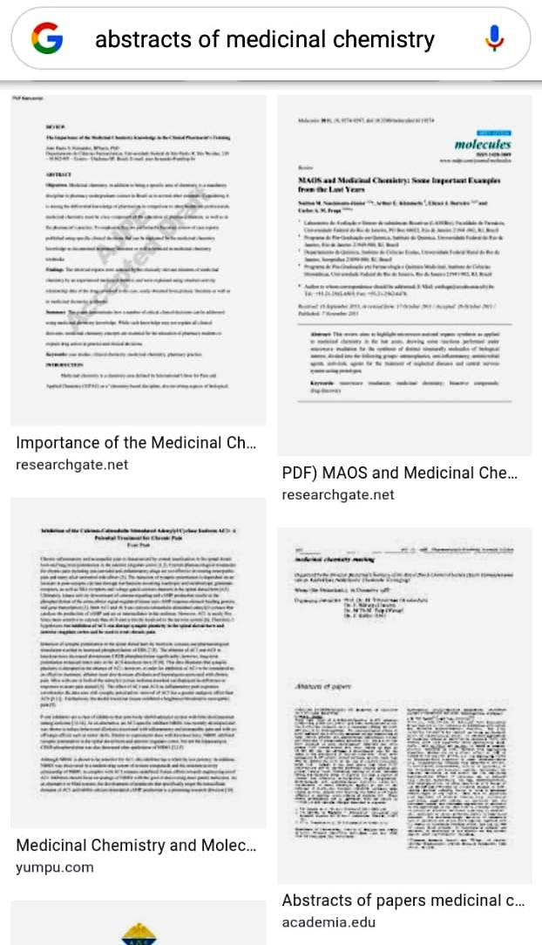
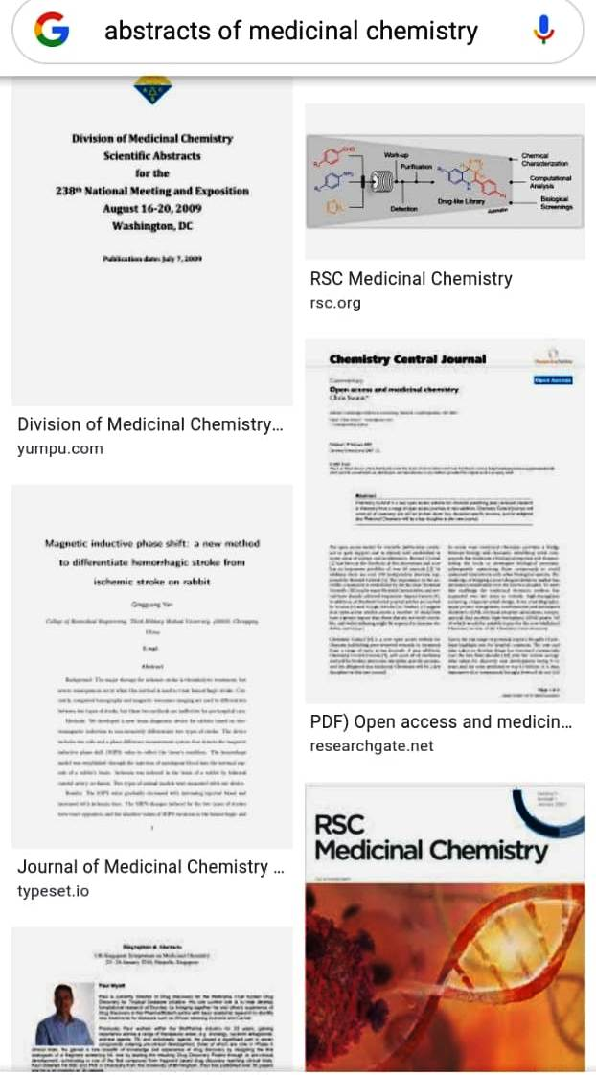
Abstract
Written summery of an article or book.
An abstract is brief summery of a research article, thesis, review, conference or any depth analysis of particular subject.

Slide 9
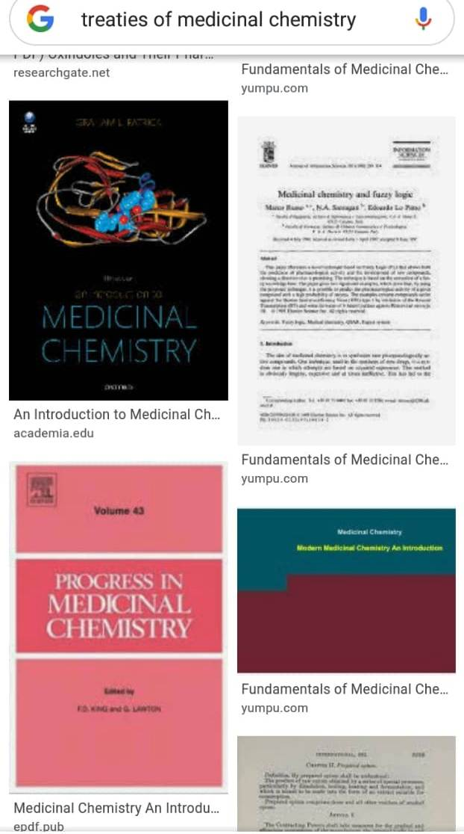
Treatise
Treatise is occurring in a broad area.
E.g. –There are 40 volumes of analytical chemistry book.
-Thus broad area (40Volumes) is also called Treatise.

Slide 10
Encyclopedia
A book or set of books giving information on many aspects of one subject & typically arranged alphabetically.
-Encyclopedia cover very very broad subject of area.
-There are also number of volume available.
E.g.-Encyclopedia of science & technology.

Slide 11
Standard Data book
Doctors are always use this kind of book.
-E.g.-Pharmaceutical Codex.

Slide 12
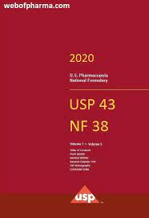
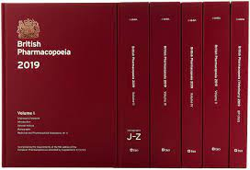
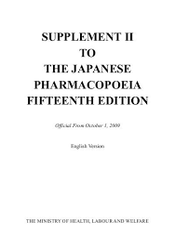
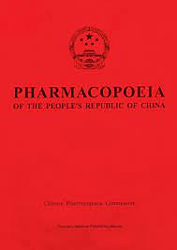
Pharmacopeias :

Slide 13
THANK YOU

